Slide 1

The Technological Institute of Textile & Sciences
Discussion Portal
Presented By:
Shikhar(20CE101) Jatin(20CE089)

Slide 2
Discussion Discussion is a very powerful factor to gain knowledge about something. It helps us to generate new ideas about a topic. It can help foster a sense of community and encourage peer to peer interaction and improve learner engagement. Discussion can take the form of debate or reflective sharing, giving learners the opportunity to expand upon and clarify their understanding of key ideas. It moves beyond more passive learning forms of reading, listening, and watching and allows the learner to actively engage with their peers and teacher and also helps people to do quick online research and readings while reflecting and as such they might cite this research to back up their point. The at-your-own-pace response time gives people a better chance to think.

Slide 3
Language Used
HTML
CSS
Javascript

Slide 4
About the Project
It is a web development based project.
It is a single user interface which defines the basic functionality of a discussion panel.
User can ask their questions and get effective answers.
User can personalize questions according to their requirements.
Different users give their responses for the questions.
Users can like and dislike the questions.

Slide 5
Results

Slide 6
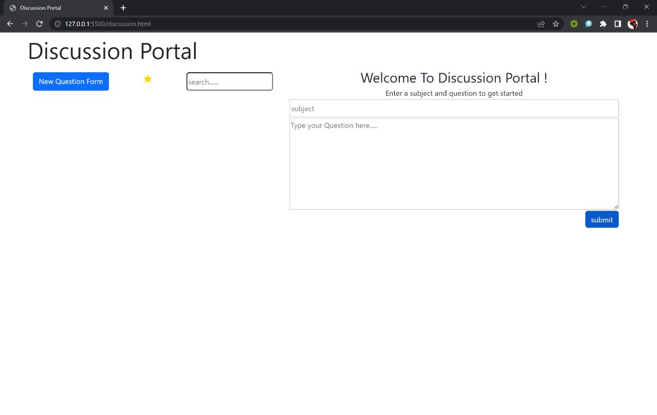
Front Page

Slide 7
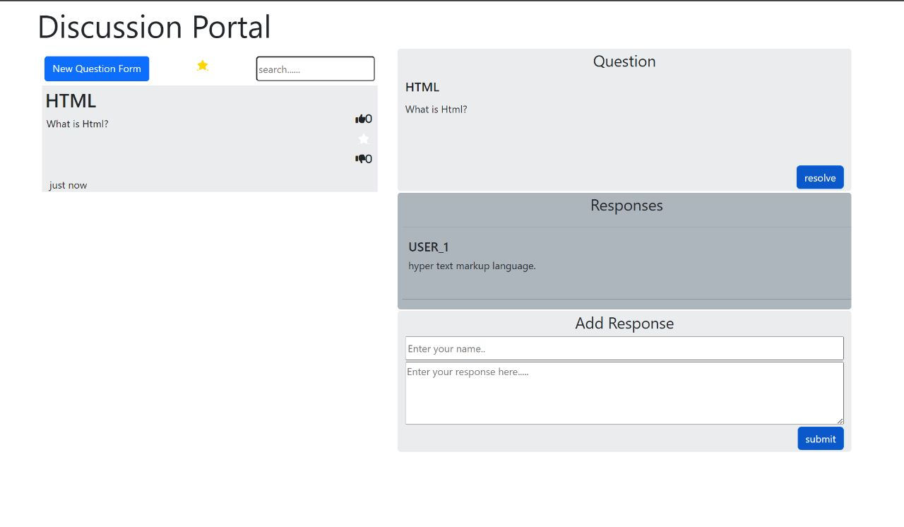

Slide 8
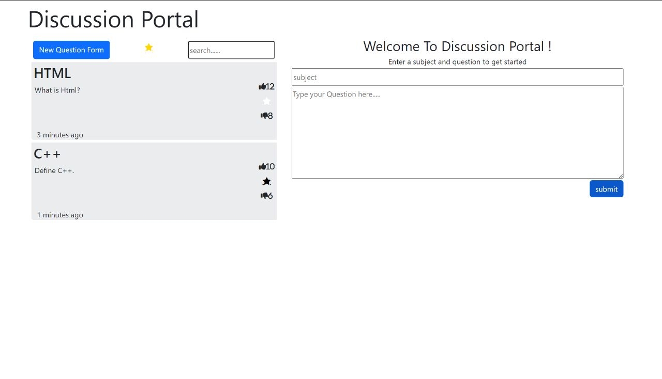

Slide 9
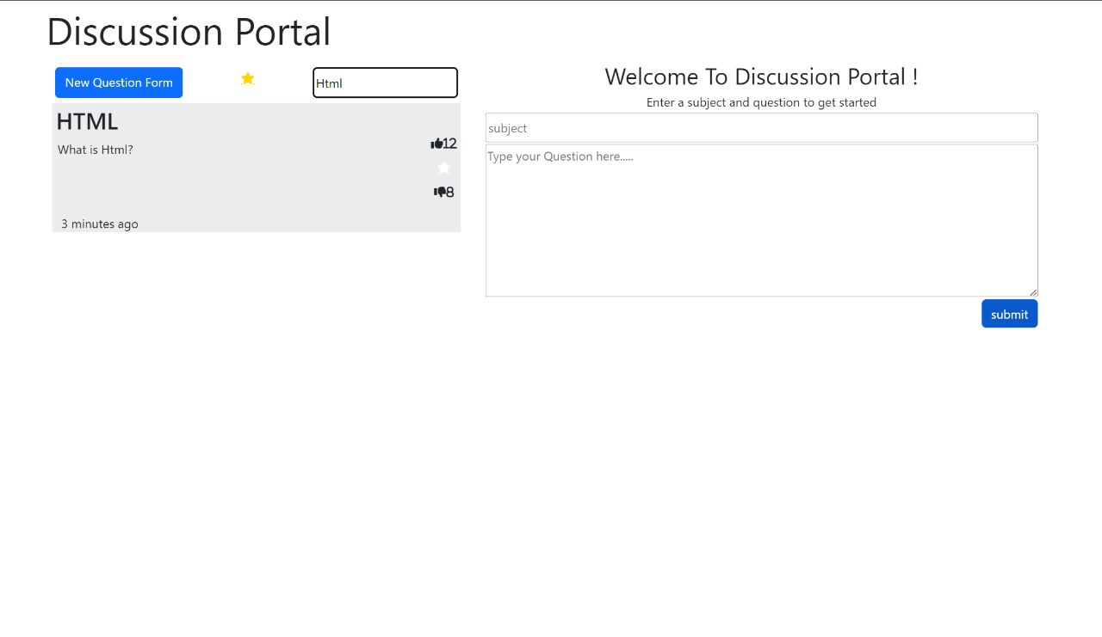

Slide 10
Thank you !

